Slide 1
Introduction to Software Bill of Materials
-Lavanya C Palakshareddy

Slide 2
Agenda
State of Software Supply Chain
What is SBOM?
SBOM Example
United States Presidential Executive Order 14028
Meeting the requirements in EO 14028
Types of SBOM
Minimum Viable SBOM
SBOM Generation Tools
Integrity of SBOM
SBOM Distribution
Q&A

Slide 3
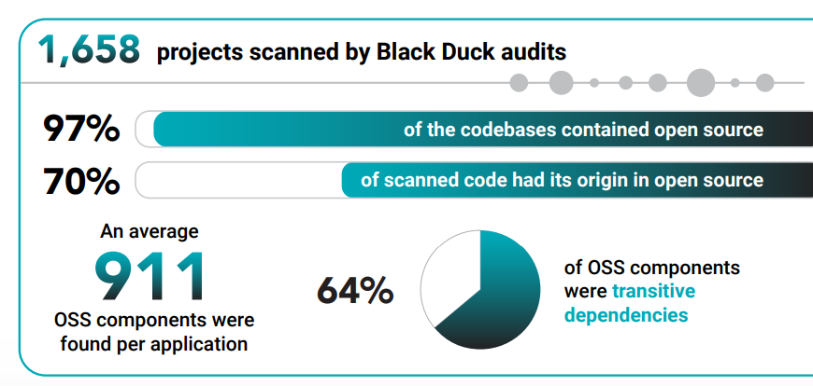
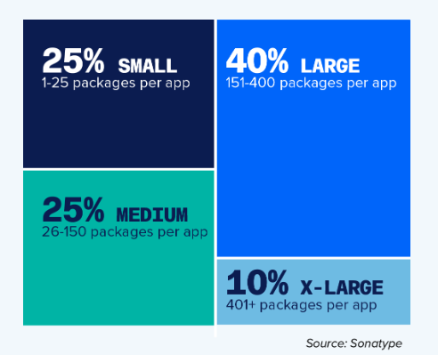
Current State of Software Supply Chains
Modern software systems involve increasingly complex and dynamic software supply chains
Application size doesn’t matter

Slide 4



Current State of Software Supply Chains (continued)
The Software Supply Chain has historically not been required to provide transparency into the composition of software systems
This lack of visibility has contributed to:
Cybersecurity Risks
Supply Chain Risks
Increased costs of software development, operations, and maintenance
Supply Chain transparency can greatly address the issues highlighted above

Slide 5
What is SBOM?
SBOM – Software Bill of Materials
An SBOM is a formal, machine-readable inventory of software Components and Dependencies, information about those Components, and their relationships*
SBOM is a way to achieve software supply chain transparency
*Source: Framing Software Component Transparency: Establishing a Common Software Bill of Materials (SBOM)

Slide 6
SBOM Example (Open SBOM Example File)

Slide 7
Why is SBOM Important Now?
United States Presidential Executive Order 14028, “Improving the Nation’s Cybersecurity” was passed on May 12th 2021.
https://www.federalregister.gov/documents/2021/05/17/2021-10460/improving-the-nations-cybersecurity
Section 4 of the Executive Order , “Enhancing Software Supply Chain Security”, outlines providing the purchaser of the software with an SBOM as one of the requirements for transparency of the supply chain.
Please find the brief definition and intent of SBOM in the executive order here:
https://www.federalregister.gov/d/2021-10460/p-153
Federal Government agencies have started requiring SBOMs from their software vendors.
https://www.fda.gov/media/173516/download
https://api.army.mil/e2/c/downloads/2024/10/17/4072ab1e/asaalt-software-bill-of-materials-policy-signed.pdf
Intel’s customers who supply Intel SOC based products are requesting SBOMs for Intel software/firmware that accompanies Intel SOCs.

Slide 8
SBOM Types:
SBOM Type | Definition
Design | SBOM of intended, planned software product Some of the components may still be unknown
Source | SBOM created directly from the development environment Includes analysis of source files, included dependencies used to build the product.
Build | SBOM generated as part of the process of building the software Includes analysis of source files, dependencies, build process ephemeral data, built components and other SBOMs.
Analyzed | SBOM generated through analysis of artifacts generated after software is built. Ex: executables, packages, containers, and virtual machine images etc.
Deployed | SBOM provides an inventory of software that is present on a system. This may be: An assembly of other SBOMs Analysis of configuration options Examination of execution behavior in a simulated or deployment environment
Runtime | SBOM generation through instrumenting the system running the software. Captures only the components present in the system as well as dynamically loaded components

Slide 9
Most Used SBOM Types
SBOM Type | Benefits | Limitations
Build | Increases confidence that the SBOM representation of the product due to information available during the build or CI/CD processes. Provides visibility into more components than just source code. Increased trust by enabling signing of the SBOM and product artifact by the same build workflow. | Potentially have to change the build process to generate this SBOM. Highly dependent on the build environment in which the build is executed. May be difficult to capture indirect and/or runtime dependencies
Analyzed | Provides visibility without an active development environment, such as legacy firmware artifacts. Does not need access to the build process. | May be prone to omissions, errors, or approximations if the tool is unable to decompose or recognize the software components precisely.

Slide 10
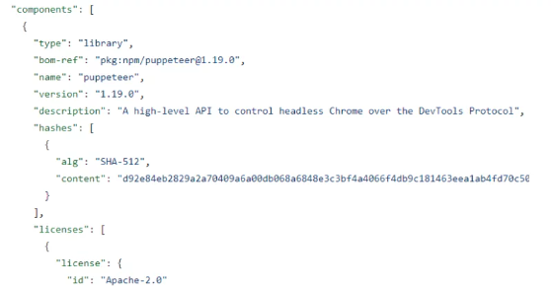


Minimum Viable SBOM
Minimum elements are the essential pieces that support basic SBOM functionality
Serve as the foundation for an evolving approach to software transparency
These minimum elements comprise three broad areas:
Minimum Viable SBOM
Data Fields:
Baseline information about each component that should be tracked
Automation Support:
Automatic generation and machine-readability to allow for scaling across the software ecosystem
Practices and Processes:
SBOM generation and use including:
Frequency,
Depth,
Known Unknowns,
Distribution and Delivery,
Access Control,
Accommodation of Mistakes

Slide 11
Data Fields:
Data Field | Description
Supplier Name | The name of an entity that creates, defines, and identifies components.
Component Name | Designation assigned to a unit of software defined by the original supplier.
Version of the Component | Identifier used by the supplier to specify a change in software from a previously identified version.
Other Unique Identifiers | Other identifiers that are used to identify a component or serve as a look-up key for relevant databases.
Dependency Relationship | Characterizing the relationship that an upstream component X is included in software Y.
Author of SBOM Data | The name of the entity that creates the SBOM data for this component.
Timestamp | Record of the date and time of the SBOM data assembly.
Source: https://www.ntia.gov/sites/default/files/publications/sbom_minimum_elements_report_0.pdf

Slide 12



Automation Support
Mainly deals with SBOM format
Automatic generation and machine-readability
Ability to scale across the software ecosystem, particularly across organizational boundaries.
The data formats that are being used to generate and consume SBOMs are:
CycloneDX
Software Package Data eXchange (SPDX)
Software Identification (SWID)
While a single standard may offer simplicity and efficiency, multiple data formats exist in the ecosystem and are being used to generate and consume SBOMs.
These standards have been deemed interoperable for the core data fields and use common data syntax representations.

Slide 13
Practices and Processes
Deals with continuous generation, information depth
Distribution of SBOMs
Practices and Processes
Frequency
Depth
Known Unknowns
Access Control
Distribution And Delivery
Accommodation of Mistakes
Notes:
Frequency: If the software component is updated with a new build or release, a new SBOM must be created to reflect the new version of the software.
If the supplier learns new details about the underlying components or wishes to correct an error in the existing SBOM data, the supplier should issue a new, revised SBOM.
Depth:
All top-level dependencies must be listed with enough detail to seek out the transitive dependencies recursively.
Known Unknowns:
The dependency data draws a clear distinction between a component that has no further dependencies, and a component for which the presence of dependencies is unknown and incomplete
Access Control:
Can be public (ex: open-source software) or
Can be confidential shared only with customers
Distribution And Delivery:
SBOMs should be available in a timely fashion to those who need them and must have appropriate access permissions and roles in place.
Binary blob appended to the software binary
Document hosted on a website
Accommodation of Mistakes:
Best practices are still evolving.
Suppliers should offer updated data as they come across issues with past SBOMs, and consumers should encourage these updates by welcoming supplements and corrections without penalty when offered in good faith.

Slide 14



SBOM Generation
SBOMs are generating using tools which do software composition analysis
The tools scan source code/binary or both to analyze the software and generate SBOMs
There are many open source as well as commercial/enterprise tools available for SBOM generation
BD Binary Analysis SBOM Generation Tool
MSFT-SBOM Tool
Genesis

Slide 15
SBOM Integrity
An SBOM consumer may be concerned about verifying the source of the SBOM data and confirming that it was not altered
Integrity and authenticity of an SBOM are most often supported through signatures and public key infrastructure
SBOM files are signed by the generator which can be verified by the consumer using public keys to ensure SBOM integrity

Slide 16
SBOM Distribution
SBOMs are hosted on the website of the software vendor.
SBOMs can be appended to the software itself. These are called binary SBOMs.
Currently at Intel, SBOMs are uploaded to RDC along with the software that is being distributed.

Slide 17
Q & A

Slide 19
Backup

Slide 20
References:
https://www.federalregister.gov/documents/2021/05/17/2021-10460/improving-the-nations-cybersecurity
https://www.ntia.gov/files/ntia/publications/ntia_sbom_use_cases_roles_benefits-nov2019.pdf
https://www.cisa.gov/sites/default/files/2023-04/sbom-types-document-508c.pdf
https://www.ntia.gov/sites/default/files/publications/sbom_minimum_elements_report_0.pdf
https://www.ntia.gov/files/ntia/publications/vex_one-page_summary.pdf
https://www.cisa.gov/sites/default/files/publications/VEX_Use_Cases_Aprill2022.pdf
https://github.com/awesomeSBOM/awesome-sbom
https://www.blackduck.com/content/dam/black-duck/en-us/reports/rep-ossra.pdf

